Slide 1

Golf Hit further and accurately?
Sang Don Lee
IOD Mini Project 1
7th of August 2020

Slide 2


Questions??
How far do PGA players drive the ball?
Is Average Driving Distance 300 yard?
Do hit longer with accuracy together?
Prediction Driver Distance and Accuracy
Notes:
helps for golf manufacturers to understand the driving distance and accuracy for the players to develop the better performed driver
for amateur golfers to understand their own driver distance and accuracy

Slide 3
Agenda
Basic Golf Terms
Project Pipeline
About the PGA 2019-2020 Data
Modelling
Improvements

Slide 4
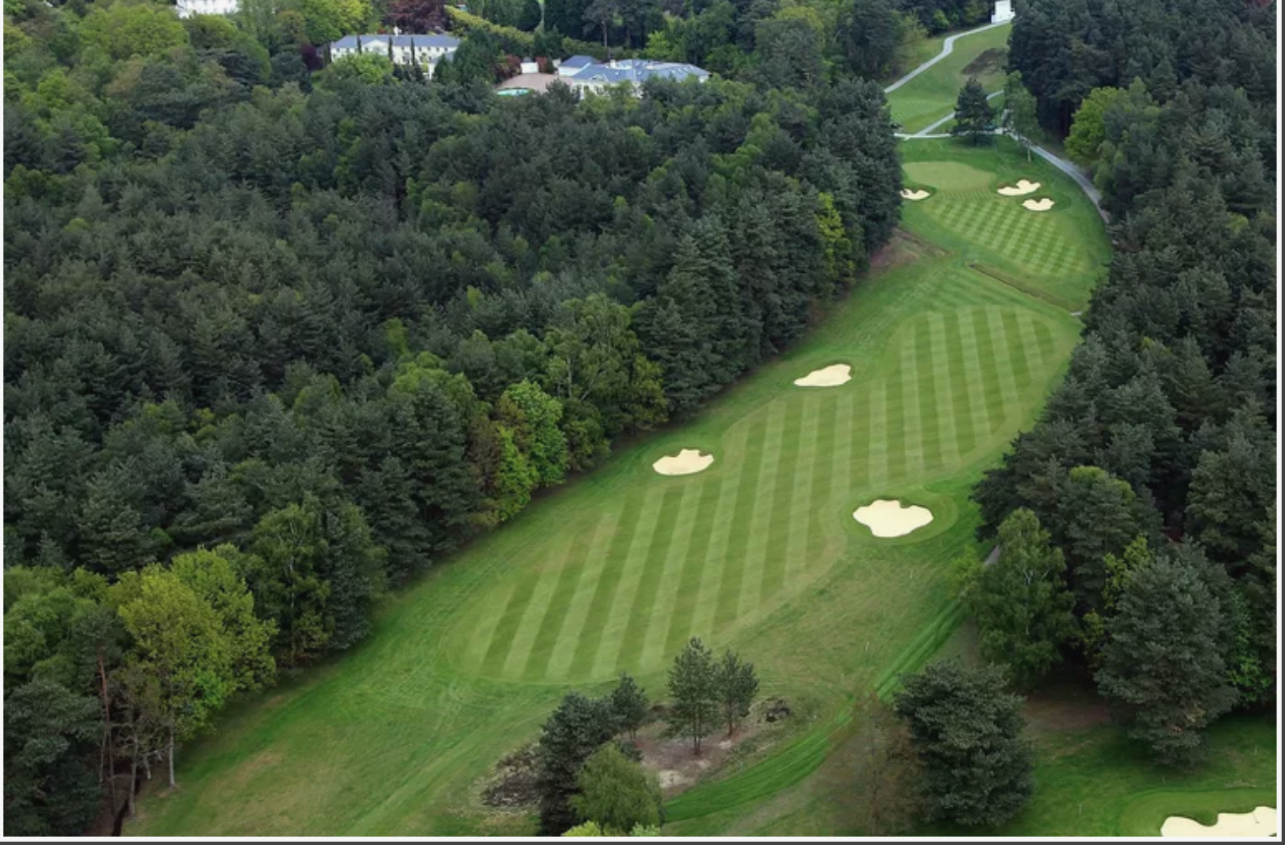
Basic Golf Terms
Driver: the club that you can hit longest (hopefully!)
Driving Accuracy:
Hitting the fairways,
No roughs, hazards, bunkers, OBs
Distance Average
based on driver hits, Par 4s, Par 5s

Slide 5
Project Pipeline
Data Collection
Data Analysis
Feature Selection
Model, Visualisation
Prediction

Slide 6
About the PGA 2020 Data
Only 8 features initially, with 1.2 M rows
After ‘Pivot’ the rows to features, 837 features
Extracted 6 interested features
305 driving distance records are missing
The data is no longer available from Kaggle as per PGA request
Notes:
11 games cancelled
9 games postponed
28 Tournaments data
324 players
1972 data points

Slide 7
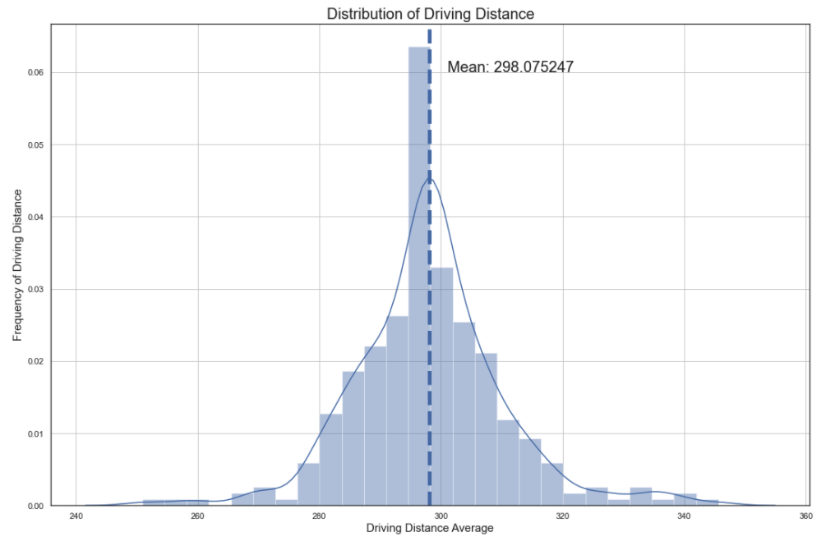
NULL Hypothesis Is the Average driving distance 300 yards?
H0 = Driving Average distance is 300 yards?
P-Value = 0.005
reject null hypothesis!!

Slide 8
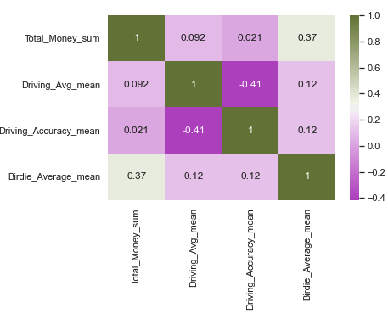
Correlation Heat Map

Slide 9
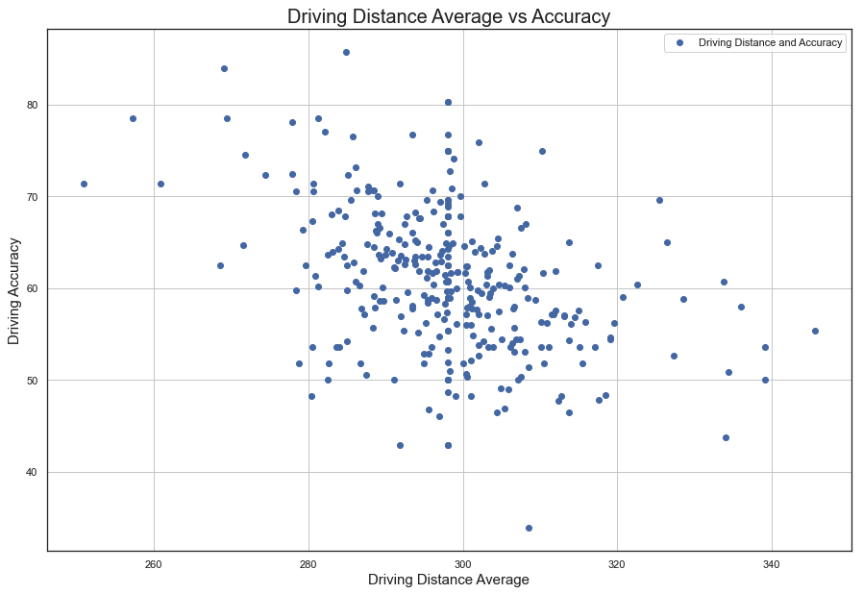
Distance VS Accuracy From Actual Data

Slide 10
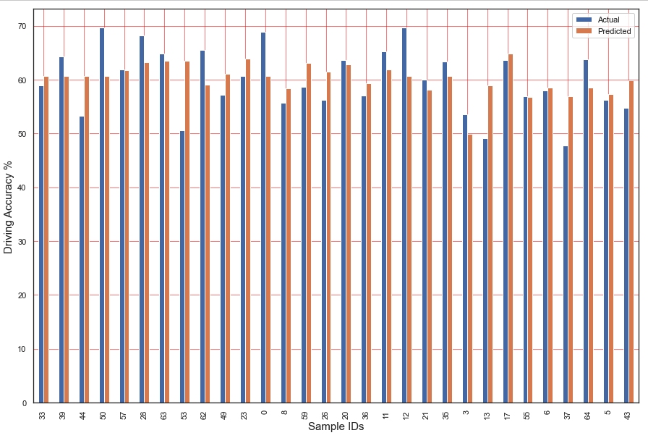
Actual vs Prediction on Driving Accuracy
Random 30 samples

Slide 11
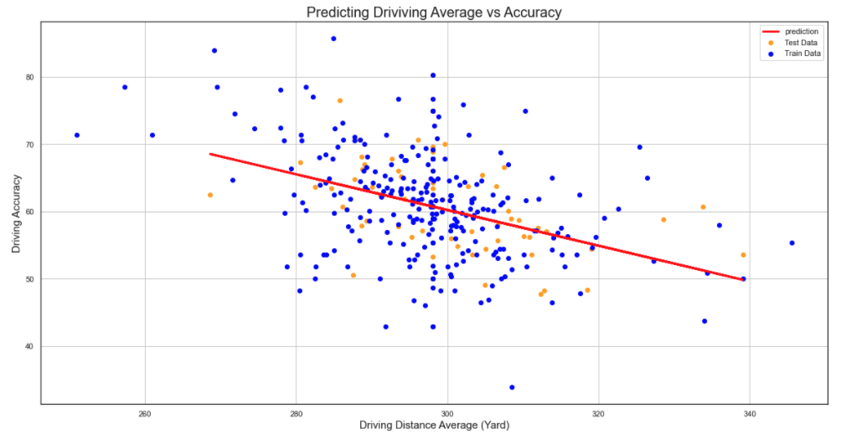
Predicting distance and accuracy
MAE: 4.78
MSE: 36.99
RMSE: 6.08
R2 score: 0.19
Notes:
intercept 139.81131935
coeff 0.26530575

Slide 12
SUMMARY & IMPROVEMENTs
We can conclude that hitting further driver reduces its accuracy
however, the R2 score is not good enough
Linear regression model with univariate does not provide good prediction
We could consider multivariate linear model
Notes:
players condition of the day
weather data, such as wind, rain, and temp
geographical data, longitude, latitude also altitude
the brands of the golf clubs
next is to predict the winning money what variables are mostly impact on the money
figure out who is the longest hitter and valuable for marketing perspective

Slide 13
Feedback and Questions?

